Slide 1
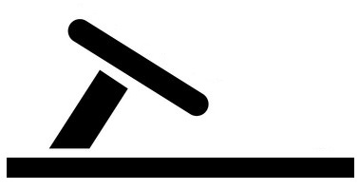
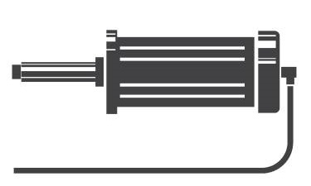

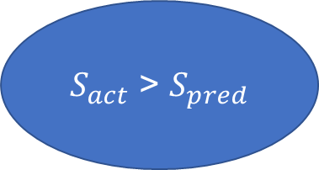
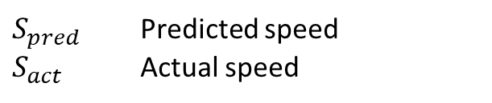

Regulate speed
True
Acceleration
Actuator unit
$S_{act}$ > $S_{pred}$
Predicted Speed ($S_{pred})$
CNN MODEL
Controller unit
Raw image
IMAGE PRE-PROCESSING
Pre-processed image
Vehicle camera
$S_{pred}$ Predicted speed
$S_{act}$ Actual speed

